Slide 1


Slide 2


PROBLEM STATEMENT
It is not very uncommon that we find students either out of curiosity or
unintentionally go for chemical experiments that result in harmful and toxic gases
being produced. For example, Carbon Monoxide (CO) and Nitrous Oxide (N2O)
have Short Term Exposure Limits (STEL) of 15 minutes and Long Term Exposure
Limits (LTEL) of 8 Hours.
Gases are everywhere, and they are always more in chemistry labs!

Slide 3

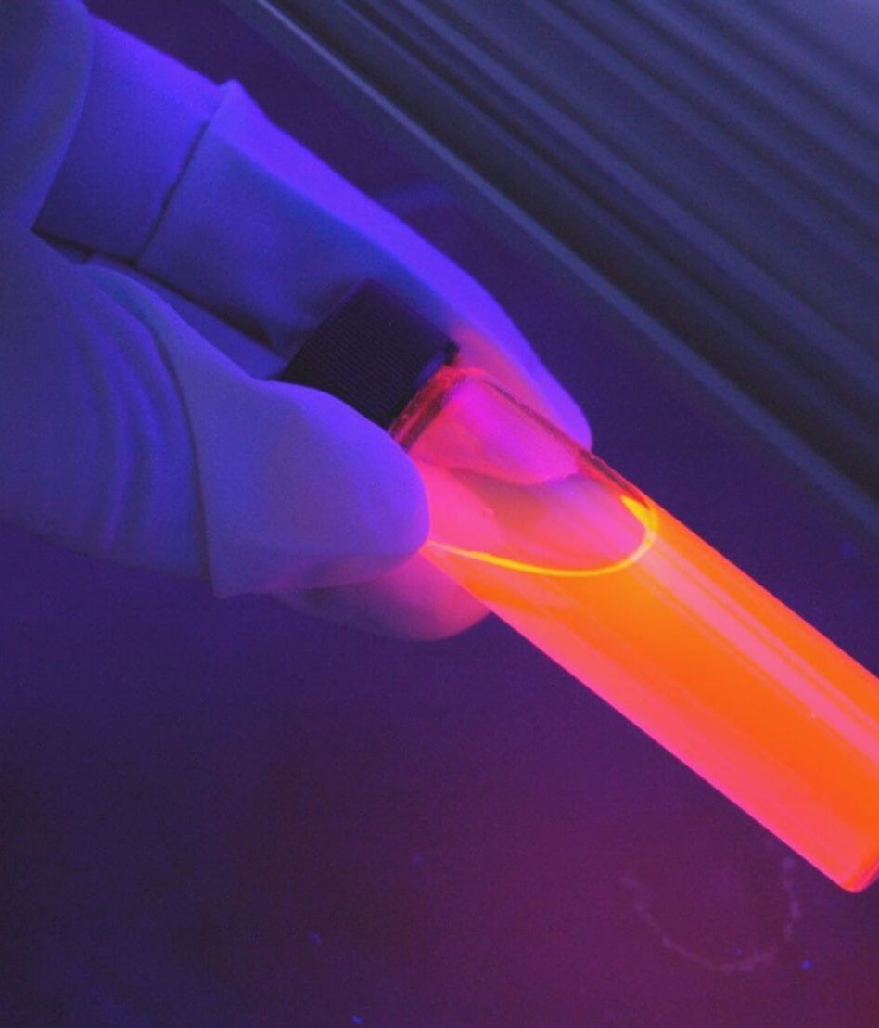
Very few laboratories at educational level have the infrastructure and the
ability to detect, identify and prevent any undesired consequences of toxins until
it’s too late.
STATISTICS
In the fiscal year 2014-2015, a total number of 280 accident cases were reported,
in which 241 students and 10 members of staff were injured, as reported by the
Honk Kong Education City.

Slide 4


WE SOLVE THIS PROBLEM
WITH OUR BRAINCHILD

Slide 5


TEKMUX 3.0
FUSION
#BEGONE_GAS
TEAM HACKATHANOS

Slide 6
WHAT MAKES A FUSION
COMPONENTS
FEATURES
Gas Sensors, Arduino Board, Raspberry Pi, Monitor
It can detect odorless and colorless gases with on board sensors, which the human sense tends to miss.
#BEGONE_GAS
IMPACT
TEAM HACKATHANOS
Exponentially reduces the likability of an untoward accident.
Yes, we make the Fusion!

Slide 7

WHAT HAPPENS WHEN FUSION SENSES AN ANOMALY
PASSES A SERIAL DATA TO THE RASPBERRY PI
API PROCESSES DATA
OUTPUT API RETURNS DATA
A Sample Timeline
The Web API extracts the required data from the tags and writes to the MySQL database
The web server and android app receive data from an endpoint and raise an alarm
A python linux daemon reads the serial data and updates it to a web API

Slide 8
Final Schematic
FUSION - TEAM HACKATHANOS

Slide 9

Fusion detected anomalies in
98 100
out of
Our Claim
cases in Laboratories under testing conditions.

